Slide 1


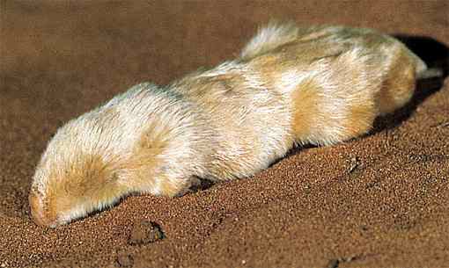
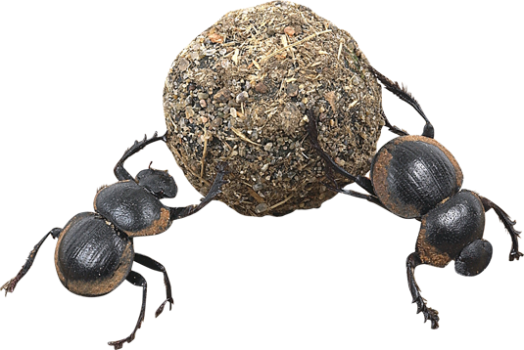

Ecology Series: Set 2
Copyright © 2005
Version: 1.0

Slide 2
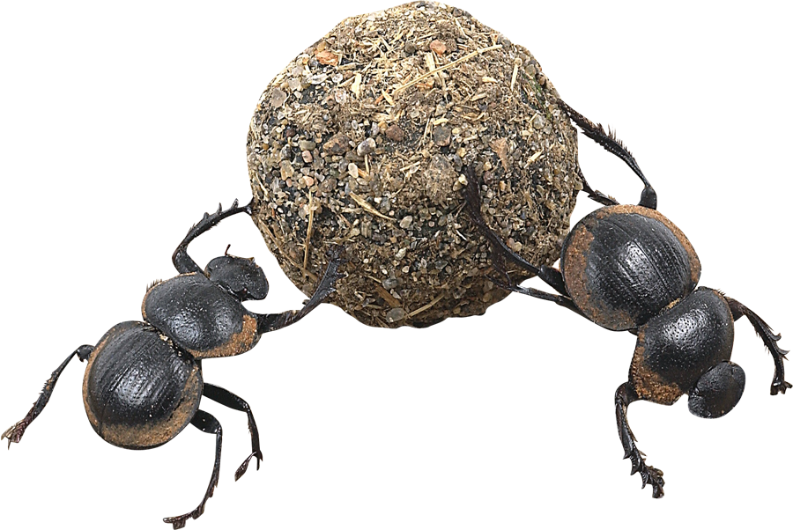
Ecological Niche
Habitat
Adaptations
The ecological niche describes the functional position of an organism in its environment.
A niche comprises:
  the habitat in which the organism lives.
  the organism’s activity pattern: the periods of time during which it is active.
  the resources it obtains
  from the habitat.
Activity patterns
Presence of other organisms
Physical conditions

Slide 3
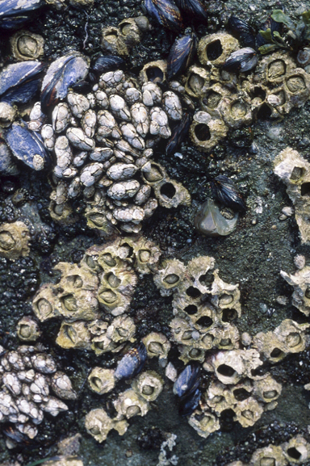

The Fundamental Niche
The fundamental niche of an organism is described by the full range of environmental conditions (biological and physical) under which the organism can exist.
The realized niche of the organism is the niche that is actually occupied. It is narrower than the fundamental niche.
  This contraction of the realized niche is a result of pressure from, and interactions with, other organisms.

Slide 4
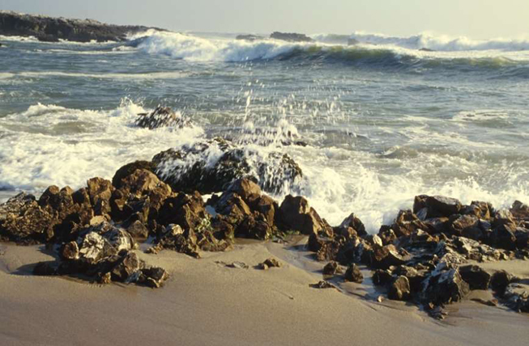
Physical Conditions
The physical conditions influence the habitat in which an organism lives. These include:
  substrate
  humidity
  sunlight
  temperature
  salinity
  pH (acidity)
  exposure
  altitude
  depth
Each abiotic (or physical) factor may be well suited to the organism or it may present it with problems to overcome.

Slide 5
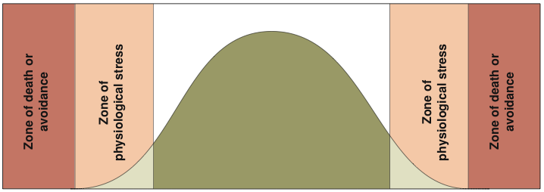


Law of Tolerance
The law of tolerance states that “For each abiotic factor, an organism has a range of tolerances within which it can survive.”
Tolerance range
Optimum range
Number of organisms
Unavailable niche
Marginal niche
Preferred niche
Marginal niche
Unavailable niche
Examples of abiotic factors that influence size of the realized niche:

Slide 6
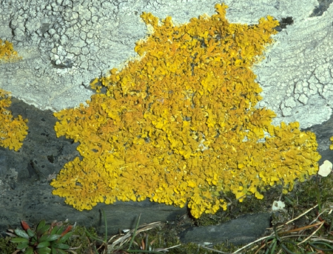
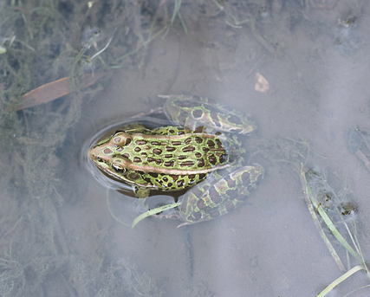
Habitat
An organism’s habitat is the physical place or environment in which it lives.
Organisms show a preference for a particular habitat type, but some are more specific in their requirements than others.
Lichens are found on rocks, trees, and bare ground.
Most frogs, like this leopard frog, live in or near fresh water, but a few can survive in arid habitats.

Slide 7
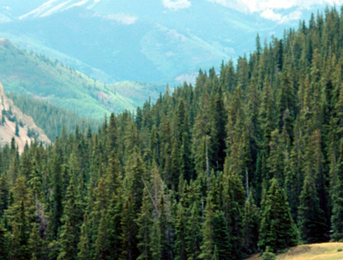
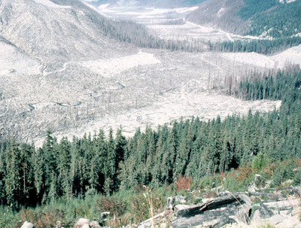
Habitat Range
An organism’s habitat is not always of a single type. Some organisms occupy a range of habitats. There are various reasons why:
  Highly adaptable in habitat requirements.
  Different, but equivalent, resources available in different habitats.
  Reduced competition for resources in sub-optimal habitats.
Habitat extremes may influence growth form, especially in plants.

Slide 8
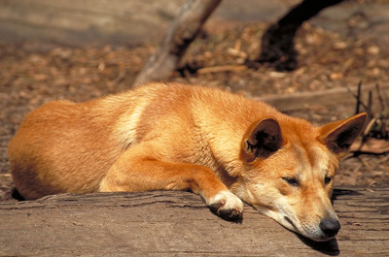
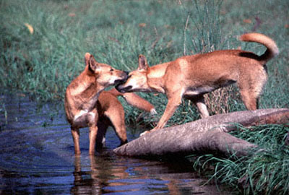
Dingo Habitats
Dingoes are a highly adaptable species found throughout Australia in ecosystems as diverse as the tropical rainforests of the north and the arid deserts in the central Australia.
  Within each of these ecosystems, they may occupy a range habitats, each one offering slightly different resources.

Slide 9
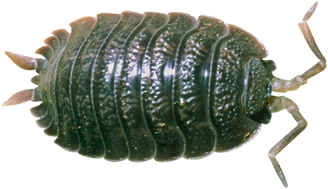
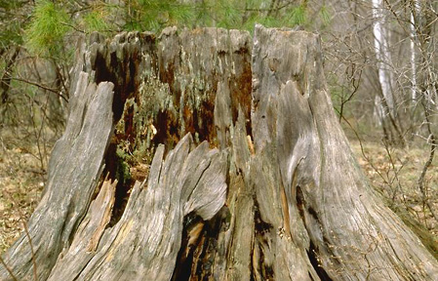
Microhabitats
A microhabitat describes the precise location within a habitat where a species is normally found. It is a small, often highly specialized, and effectively isolated location.
  The term microhabitat generally applies to invertebrates which do not forage widely.
  Example: Within a woodland habitat, woodlice may be found in the microhabitat provided beneath the bark of the rotting wood.
Woodlouse

Slide 10
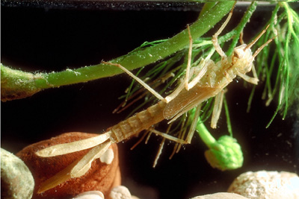
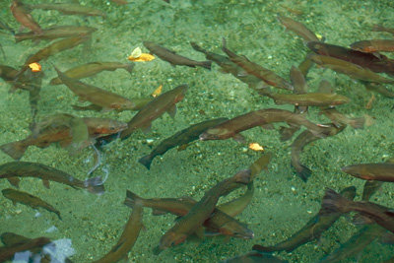
Habitat Preference
Organisms may select particular areas within their general habitat, even in apparently homogeneous environments, such as water. This is termed habitat preference.
  Example: Aquatic organisms may show a preference for a particular substrate type, water depth or velocity, water clarity, or degree of vegetation cover or habitat disturbance.
Knowledge of habitat preference can be used to protect species in their environment.
Damselfly nymph
Rainbow trout

Slide 11
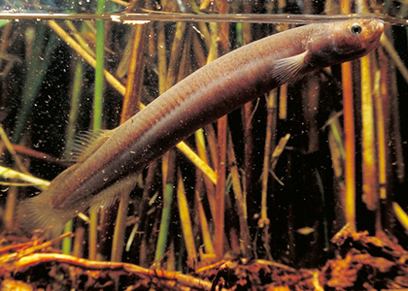
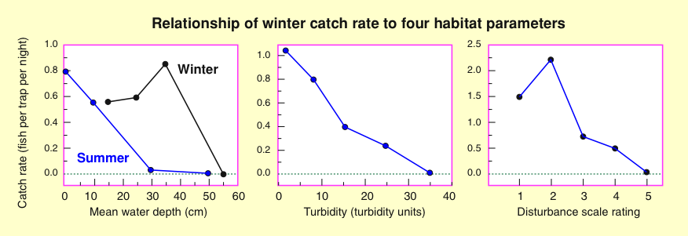
Mudfish Habitat Preference
The New Zealand black mudfish is a wetland species of uncertain conservation status.
Its habitat preference has been described in relation to mean water depth, turbidity, and degree of habitat disturbance.
Black mudfish Neochanna diversus

Slide 12
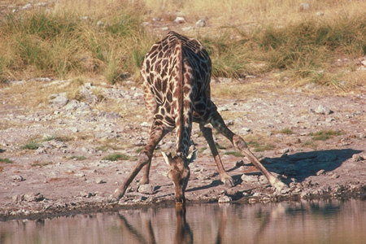
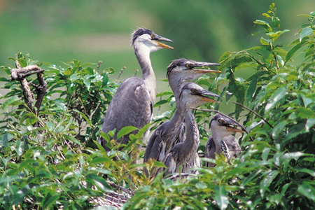
Resources in a Habitat
The habitat provides organisms with the following resources:
  Food and water sources
  Mating sites
  Nesting sites
  Predator avoidance
  Shelter from climatic extremes
However, the organism may or may not have the adaptations to exploit all the available resources fully.

Slide 13
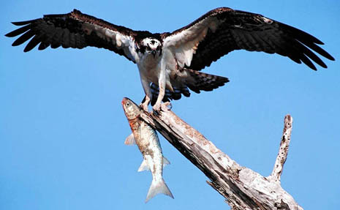
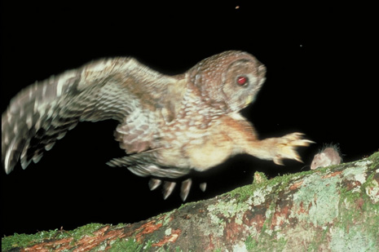

Adaptations
An adaptation (or adaptive feature) is an inherited feature of an organism that enables it to survive and reproduce in its habitat.
Adaptations are the end result of the evolutionary changes that a species has gone through over time.
  Adaptations may be:
    behavioral
    physiological
    structural (morphological).
Osprey: a diurnal bird of prey
Spotted owl: a nocturnal bird of prey

Slide 14
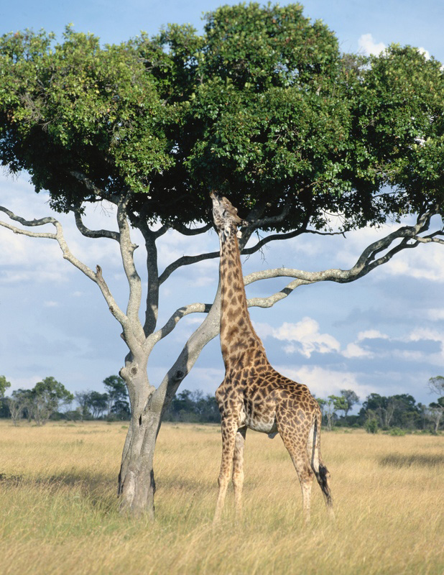
Exploiting a Habitat
Organisms have adaptations to exploit, to varying extents, the resources in their habitat.
Where resource competition is intense, adaptations enable effective niche specialization and partitioning of resources.
  In the African savanna, grazing and browsing animals exploit different food resources within the same area or even within the same type of vegetation.

Slide 15
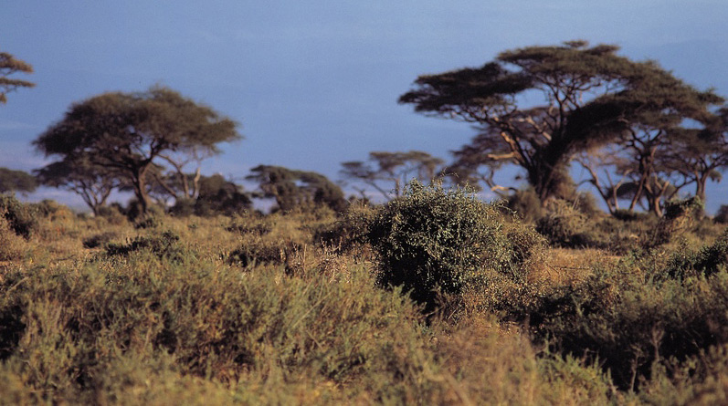
Plants and Browsers
The large thorns and dense, tangled growth form of the acacias of the African savanna are adaptations to counter the effects of browsing animals such as antelope.
Acacia forest

Slide 16
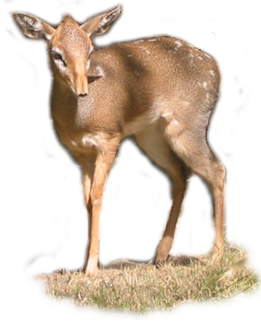
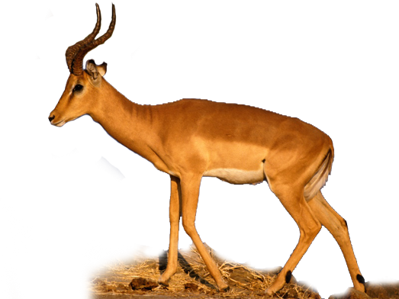
African Browsers 1
Tiny dik diks can only browse the lowest acacia branches, less than 1 m above the ground. Their small pointed muzzles avoid the hooks and spines that defeat clumsier browsers.
Impalas, with their larger muzzles and longer necks, can reach three times higher than dik diks.
Dik dik
30.5-40.5 cm at shoulder
3-7 kg
Impala
80-90 cm at shoulder
40-65 kg

Slide 17
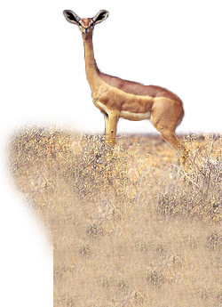
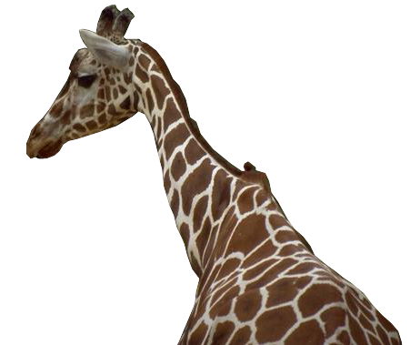
African Browsers 2
Gerenuk
90-105 cm at shoulder
28-52 kg
The disproportionately small head of the gerenuk allows it to browse between the thorny branches. Swiveling hip joints allow it to stand erect and reach taller branches.
Giraffes browse the upper branches of the acacia.
Its long (45 cm) muscular tongue is impervious to thorns and its long neck is so mobile that its head can tip vertically.
Giraffe
3.3 m at shoulder
6 m to crown
0.6-1.9 tonne

Slide 18
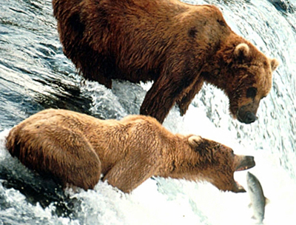
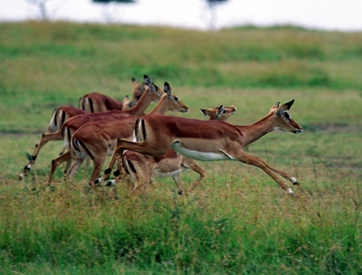
Purposes of Adaptations
Organisms have adaptations for:
  Biorhythms and activity patterns, e.g. nocturnal behavior
  Locomotion (or movement)
  Defense of resources
  Predator avoidance
  Reproduction
  Feeding
These categories are not mutually exclusive.

Slide 19
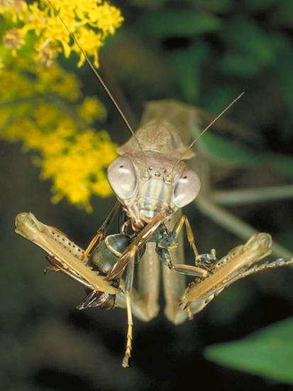
Types of Adaptations
Structural adaptations: physical features of an organism, e.g. presence of wings for flight.
Behavioral adaptations:
the way an organism acts, e.g. mantid behavior when seeking, capturing, and manipulating prey.
Functional (physiological) adaptations:
those involving physiological processes, e.g. the female mantid produces a frothy liquid to surround and protect the groups of eggs she lays.
Praying mantis

Slide 20
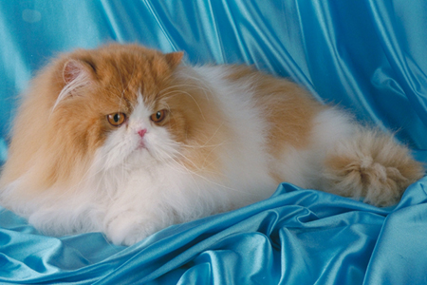
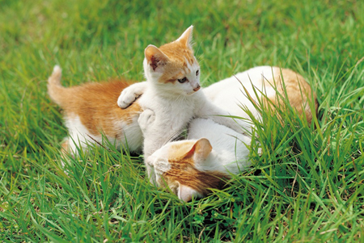
Adaptations and Fitness
Fitness is a measure of how well suited an organism is to survive in its habitat and its ability to maximize the numbers of offspring surviving to reproductive age.
Adaptations are distinct from properties which, although they may be striking, cannot be described as adaptive unless they are shown to be functional in the organism’s natural habitat.
The fur of this cat is a striking property...
Mothering and play behaviors are adaptive

Slide 21
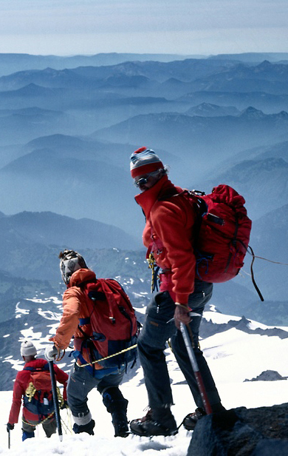
Acclimatization
Acclimatization (physiological adjustment) describes changes (usually physiological or behavioral) made during an individual’s lifetime to adjust to changing environmental conditions.
  For example, when a person spends time at high altitude, physiological changes to the circulatory and respiratory systems improve efficiency in the thinner air.
  These adjustments should not be confused with genetic adaptation.

Slide 22
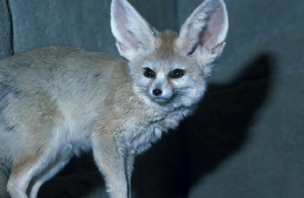
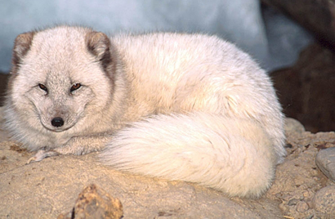
Adaptations to Climate
The adaptations typical of mammals living in hot climates include features to facilitate heat dissipation and reduce heat gain:
  A small body size, lightweight fur, and long ears, legs and nose.
The adaptations typical of mammals living in cold climates include features to reduce heat loss to the environment:
  Compact body shape with small ears, short legs and nose, and dense fur.
Fennec fox of the Sahara
Arctic fox

Slide 23
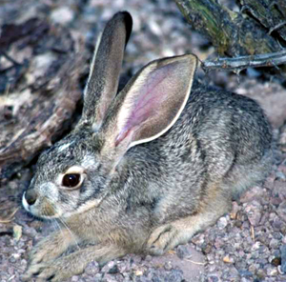
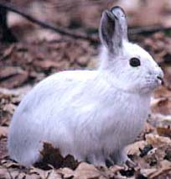
Ear Length in Mammals
The external ears of many mammals are used as important organs to assist in controlling gain and loss of body heat.
  The ears of rabbits and hares (Lepus) native to hot, dry climates, such as those in the south-western USA, are very large relative to body size.
  In contrast, the ears of the Arctic hare, which lives in the northern tundra zones, are relatively short.
A reduction in size of the extremities (ears, limbs, and noses) is typical of cold adapted species.
Jack rabbit, L. californicus
Arctic hare, L. arcticus

Slide 24
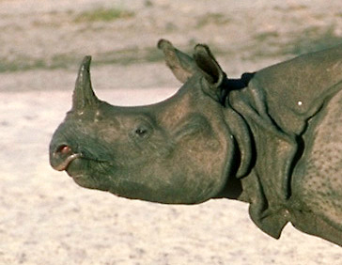
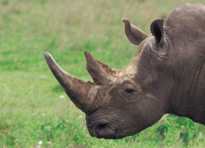
Rhinoceros Horns
Differences between species cannot always be convincingly interpreted as adaptations to a particular environment.
Horns are clearly adaptive: horns add effectiveness to defensive and attack behaviors.
  However, it is not clear that the possession of one horn (Indian rhino) or two horns (black rhino) is necessarily related directly to the environment in which these animals live.
Great Indian rhinoceros
Black rhinoceros

Slide 25
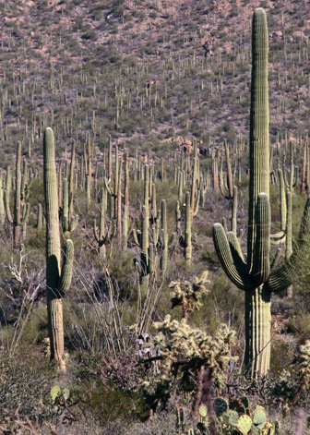
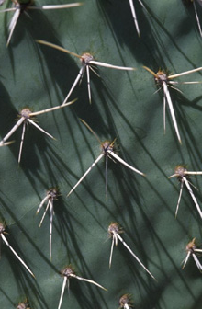
Plant Adaptations
The adaptations found in plants reflect both the plant’s environment and the type and extent of predation to which the plant is subjected.
  Many plant adaptations are concerned with maintaining water balance. Terrestrial plant species show a variety of structural and physiological adaptations for water conservation.
  Plants evolve defenses, such as camouflage, spines, thorns, or poisons, against efficient herbivores.

Slide 26
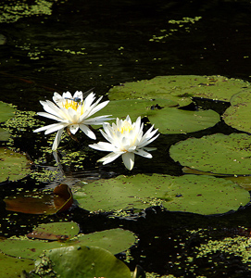
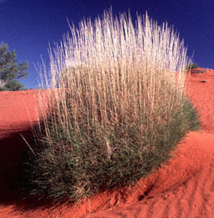
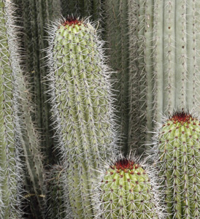
Water Balance in Plants
Plants can be categorized according to their adaptations
to particular environments:
  Hydrophytes: live partially or fully submerged in water.
  Halophytes: salt tolerant species found in coastal and salt marsh environments.
  Xerophytes: arid adapted species found in hot and cold deserts.
Hydrophyte: water lily
Halophyte: spinifex
Xerophyte: cactus

Slide 27
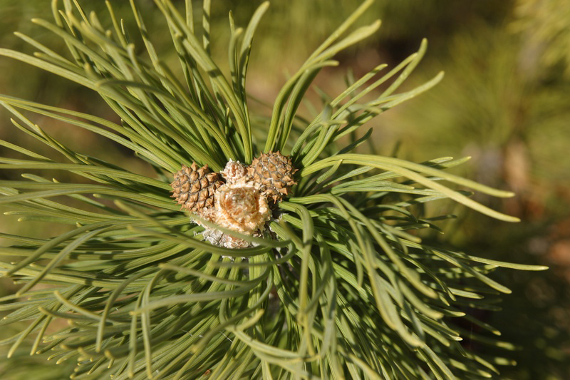
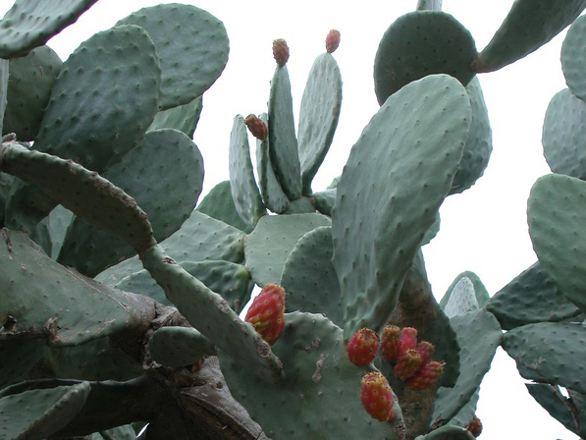
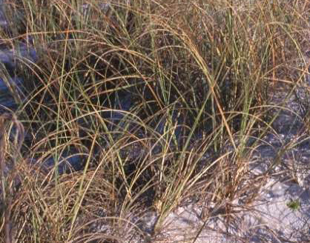
Conserving Water
Adaptation for water conservation | Effect of adaptation | Example
Thick, waxy cuticle to stems and leaves | Reduces water loss through the cuticle | Pinus spp., ivy, sea holly, prickly pear
Reduced number of stomata | Reduces the number of pores for water loss | Prickly pear, Nerium sp.
Leaves curled, rolled or folded when flaccid | Reduces surface area for transpiration | Rolled leaf: marram grass, Erica spp.
Pinus
Prickly pear: Opuntia
Marram grass

Slide 28
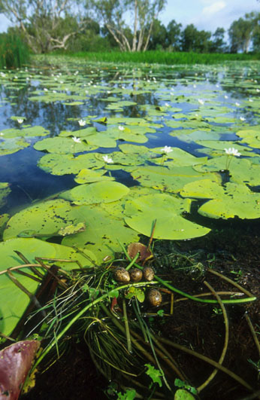
Adaptations of Hydrophytes
Hydrophytes are plants that have adapted to living either partially or fully submerged in water.
Typical features of submerged
hydrophytes, e.g. the water lily
(Nymphaea alba), include:
  Large, thin, floating leaves
  Elongated petioles (leaf stalks)
  Reduced root system
  Aerial flowers
  Little or no waxy cuticle
  Poorly developed xylem tissue
  Little or no lignin in vascular tissues
  Few sclereids or fibers.

Slide 29
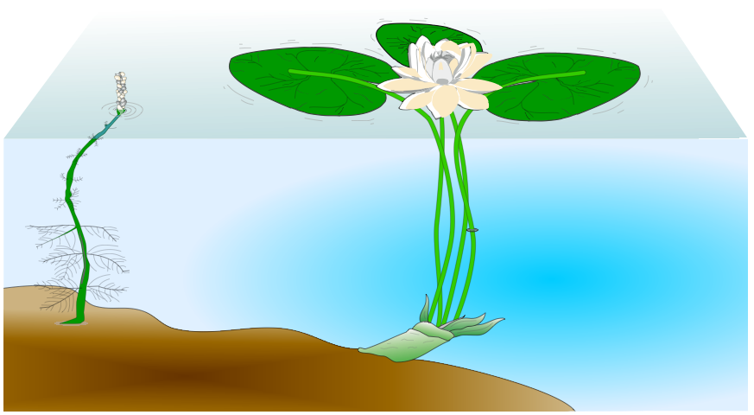

Hydrophytic Plants
The aquatic environment presents different problems to those faced by terrestrial plants. Water loss is not a problem and, supported by the water, they require little in the way of structural tissues.
Floating leaves have a high density of stomata on the upper surface
Cross section through the petiole
Submerged leaves are well spaced, finely divided, and taper towards the surface
Water milfoil
Myriophyllum spicatum
Vascular bundles
Water lily
Nymphaea alba
Cortex
Abundant, large air spaces

Slide 30

Adaptations of Halophytes
Mangroves are halophytes, adapted to grow in saline, intertidal environments, where they form some of the most complex and productive ecosystems on Earth.
Mangrove adaptations include:
  Ability to secrete salt or accumulate it in older leaves.
  Specialized tissue that allows water, but not salt, to enter the roots.
  Tissue tolerance for high salt levels.
  Extensive root systems give support in soft substrates; oxygen enters the roots through pneumatophores.
Mangrove forest, Queensland

Slide 31




Mangrove Adaptations
Salt glands in the surface layers of leaves secrete salt (salt excretors).
Oxygen diffuses through the spongy tissue of the pneumatophore to the rest of the plant.
Salt may accumulate in older leaves before they fall.
Water level at high tide
Pneumatophores (breathing roots) arise from the cable roots.
Prop roots descend from the trunk to provide additional support.
Cable roots radiate from the trunk. Fine feeding-roots grow off these radial roots and create a stable platform.
Specialized root membranes in some mangroves prevent salt from entering their roots (salt excluders).

Slide 32

Dry Desert Plants
Plants adapted to dry conditions are called xerophytes and they show structural and physiological adaptations for water conservation.
  Desert plants, e.g.
  cacti, cope with low
  rainfall and potentially high transpiration rates.
  They develop strategies
  to reduce water loss,
  store water, and tap into available water supplies.
Leaves modified into spines or hairs to reduce water loss
Surface area reduced by producing a squat, rounded shape.
Stem becomes the major photosynthetic organ, and a reservoir for water storage.
Shallow, but extensive fibrous root system
Water table low

Slide 33




Tropical Forest Plants
Tropical forest plants live in areas of often high rainfall. Therefore, they have to cope with high transpiration rates.
Funnel shaped leaves channel rain
Shallow fibrous root system
Water loss by transpiration
Water table high

Slide 34


Ocean Margin Plants
Ocean margin plants, e.g. intertidal seaweeds and mangroves, must cope with high salt content in the water.
Some mangrove species take in brackish water and excrete the salt through glands in the leaves.
Seaweeds growing in the intertidal zone tolerate exposure to the drying air every 12 h.
Mangrove pneumatophores

Slide 35


Insectivorous Plants
Sundew (Drosera)
Insectivorous plants are plants that obtain extra nutrients by capturing and digesting small invertebrates.
They are commonly found in marginal habitats such as acid bogs or nutrient-poor soils.
  They are often small because of the marginal habitats in which they live.
  They make their own sugars through photosynthesis, but obtain nitrogen and minerals from animal tissue.
  Leaf modifications act as traps. Usually the traps contain special glands that secrete digestive enzymes.
Pitcher plant

Slide 36

Venus Flytrap
The Venus flytrap consists of two, lobed modified leaves that can rapidly close together to trap prey (usually small invertebrates).
  The trigger for closing is a touch on the sensory hairs of the leaves.
Each leaf has a spring-like hinge of thin-walled cells down to its midrib.
When triggered, these cells rapidly lose water causing the two halves of the leaf to close together.
Insects touch these trigger hairs on the inside leaf surface.
Spines line the edge of the leaf, creating a cage when the leaf folds together.

Slide 37



Animal Adaptations
No animal exists independently of its environment, and different environments present animals with different problems.
Animals exhibit a great diversity of adaptations. These enable them to live within the constraints of their particular environment.
Arid
Extreme cold
Forested

Slide 38


Rodents and Lagamorphs
Lagamorphs (rabbits and hares) and rodents are two successful and highly adaptable mammalian orders.
  Although different in many respects, they share similar adaptations, including early maturity, high reproductive rates, chisel-like teeth, and dietary flexibility.
They are found throughout the world, except in Antarctica in habitats ranging from Arctic tundra to desert and semi-desert.
Capybara: the world’s largest rodent
Jackrabbit: a lagamorph

Slide 39

Structural Adaptations in Rabbits
Structural adaptations
Widely spaced eyes gives a wide field of vision for surveillance of the habitat and detection of danger.
Long, mobile ears enable acute detection of sounds from many angles for predator detection.
Long, strong hind legs and large feet enable rapid movement and are well suited to digging.
Cryptic coloration provides effective camouflage in grassland habitat.
Rabbits are colonial mammals that live underground in warrens and feed on a wide range of vegetation.
Many of their more obvious structural adaptations are associated with detecting
and avoiding predators.

Slide 40

Functional Adaptations in Rabbits
Functional (physiological) adaptations are associated with physiology.
  The functional adaptations of
  rabbits are associated with
  detecting and avoiding predation,
  and maintaining populations
  despite high losses.
Functional adaptations
High reproductive rate enables rapid population increases when food is available.
Keen sense of smell allows detection of potential threats from predators and from rabbits from other warrens.
Microbial digestion of vegetation in the hindgut enables more efficient digestion of cellulose.
High metabolic rate and fast response times enables rapid response to dangers.
Hawks are major predators of rabbits

Slide 41

Behavioral Adaptations in Rabbits
The behavioral adaptations of rabbits reflect their functional position as herbivores and important prey items in many food webs.
Behavioral adaptations
Freeze behavior when startled reduces the possibility of detection by wandering predators.
Thumps the ground with hind legs to warn others in the warren of impending danger.
Lives in groups with a well organized social structure that facilitates cooperative defense.
Burrowing activity provides extensive underground habitat as refuge from predators.
Freezing is a typical behavior when threatened

Slide 42

Monitor Lizards 1
Goannas or monitor lizards are top predators, found in a wide range of habitats, from aquatic to arid semi-desert.
  They are strict carnivores and eat a range of animal species, including carrion.
  They are diurnal and active in all seasons. Body temperatures of up to 38°C are maintained through basking and other behaviors.

Slide 43


Monitor Lizards 2
Adaptations of monitor lizards (Varanus spp.) include:
Skin color is related to the environment. The skin of species in arid regions is highly reflective.
Strong neck and jaw muscles aid in holding, shaking, and subduing prey.
The gular (throat) pouch is inflated during threat displays. Rapid movements of the gular region when the mouth is open is used as a cooling mechanism.
The upper jaw can move independently of the rest of the skull to facilitate swallowing of prey whole.

Slide 44

Marsupial Mole 1
The marsupial mole (Notoryctes typhlops) is well adapted to life underground. Its small size, tubular body shape, and heavily buttressed head and neck are typical of burrowing animals. Both species of Notoryctes are endemic to Australia.
  Notoryctes occurs in desert regions in sandy soils associated with river flats. They feed on a variety of invertebrates.
  Jacobson’s organ (chemical sense) and sense of hearing are well developed.
  The photo right, shows some structural features in an early museum specimen.
Spade-like claws
Rear facing pouch

Slide 45
Marsupial Mole 2
Marsupial moles are well equipped for rapid burrowing through sand, both sleeping and feeding below ground:
Long, silky fur reduces friction through the sandy soil. The dense fur covers external ear openings.
A horny shield protects the nostrils.
The naked, horny tail presses against the substrate and braces the spine when digging.
Blind, with no external evidence of an eye and no optic nerve.
Forefeet can grasp prey but are poor at manipulating it.

Slide 46

Red Kangaroo 1
The red kangaroo (Macropus rufus) is one of the largest living marsupials. It is superbly adapted to the arid and semi-arid regions of Australia.
  Red kangaroos are active mainly at night, resting in scrapes under cover. They move in groups of 2-10, covering a home range of 8 km² (or larger when resources are scarce).
  Females may breed all year, mating soon after giving birth, with the embryo remaining dormant until the pouch is vacant.

Slide 47

Red Kangaroo 2
Robust, high crowned molars are replaced as they wear down.
Red kangaroos are well adapted for rapid, hopping locomotion and survival in arid habitats:
Dense, fine fur provides insulation. Fur is reflective, especially on the flanks.
Thin, highly vascularized skin, especially on the forelimbs, to assist heat loss by evaporation.
Front paws and wrist relatively unspecialized compared with the hind limb.
Stout, tapering tail acts as a fifth limb in slow 5-point movement and a counterweight when hopping.
Hind limbs much more heavily muscled and longer than the fore limbs.

Slide 48


Kea Adaptations 1
The kea is one of the world’s few alpine parrots, found only in the high country of New Zealand’s South Island.
  Kea are hardy, adaptable, and highly social. Their curious nature helps when investigating and exploiting new food sources.
  They are versatile feeders, taking berries, roots, shoots, insect larvae and carrion.
  Kea congregate in groups to feed and explore. This sociality aids in exploration of their environment.
Kea (Nestor notabilis)

Slide 49

Kea Adaptations 2
Highly intelligent with an ability to learn through play.
The beak is strong, with considerable manipulative power.
Dense plumage provides insulation against alpine extremes. The dull green color is suitable camouflage in alpine forest. Scarlet underwings are visible in flight.
A strongly built and robust body is an advantage in alpine environments.
Strong claws for holding and manipulating foods, and investigating novel objects.

Slide 50


New Zealand Bats
Long, curved claws well suited to roosting in trees.
New Zealand’s native bats, the NZ long tailed bat (Chalinolobus tuberculatus) and the rarer
NZ lesser short tailed bat (Mystacina tuberculata) have slightly different feeding niches, habitat preferences, and activity patterns.
  Chalinolobus roosts in colonies, hibernating in autumn and winter. Mystacina does not hibernate.
  Chalinolobus flies at dusk, feeding solely on small flying insects.
  Mystacina is nocturnal and feeds on the ground, taking forest fruits, nectar, pollen, and insects.
Chalinolobus
Fine, silky hair provides insulation.
Mystacina

Slide 51

Northern Mole
The northern or common mole (Talpa europaea) is a widespread insectivore found throughout much of Britain and Europe.
They are well adapted to life underground, where permanent tunnels form a complex network used for feeding and nesting.
Enlarged, spade-like forefeet form shovel-blades for digging. Claws are broad and stiff hairs widen the foot.
Short, velvety dark fur
can lie in any direction, facilitating movement forward or backwards.
Clawed hindfeet provide grip and move soil away.
Keen sense of smell, but with rudimentary eyes, they are almost blind.
Small, tubular body, with well buttressed head and neck are typical of burrowing species.

Slide 52

Snow Bunting 1
The snow bunting (Plectrophenax nivalis) is a small ground feeding bird that lives and breeds in the Arctic region.
  Snow buntings are widespread throughout the Arctic and sub-Arctic islands. They are active 24 hours a day, resting for only 2-3 hours within that period.
  Snow buntings migrate up
  to 6000 km but are always
  found at high latitudes.
  They have the unique
  ability to molt very rapidly
  after breeding, changing
  color quickly from a brown
  summer plumage to the
  white winter plumage.
North
Pole
Siberia
North
America
Summer breeding area
Asia
Winter migratory destination
Europe

Slide 53


Snow Bunting 2
Adaptations of the snow bunting (Plectrophenax nivalis) include:
The internal spaces of the dark colored feathers are filled with pigmented cells. More heat is lost from the dark summer plumage.
During snow storms or periods of high wind, snow buntings will burrow into snowdrifts for shelter.
Snow buntings, on average, lay 1-2 eggs more eggs than equivalent species further south. In continuous daylight, and with an abundance of insects at high latitudes, they are able to rear more young.
White feathers are hollow and filled with air, which acts as an insulator. Less heat is lost from the white winter plumage.

Slide 54


Competition
Competition describes the active demand between two or more organisms for a resource.
Competition may be:
  Intraspecific: between individuals of the same species.
  Interspecific: between individuals of different species.
Each competitor is inhibited in some way by the interaction.
Intraspecific competition: hyaenas
Interspecific competition on a reef

Slide 55



Competition and Niche Size
Realized niche of species
Competition affects the size of a competitor’s realized niche.
The effect is dependent on the intensity and type of the competition.
  Niches are narrower with moderate interspecific competition (Fig. 1).
  Intense interspecific competition results in a very narrow realized niche as species specialize to exploit a narrower range of resources (Fig. 2).
  Intense intraspecific competition results in a broader realized niche as individuals are forced to occupy suboptimal conditions (Fig. 3).
Fig. 1
Narrower niche
Fig. 2
Broader niche
Fig. 3
Possible tolerance range

Slide 56

Gause’s Principle
Gause’s competitive exclusion principle states:
“two or more resource-limited species, having identical patterns of resource use, cannot coexist in a stable environment:
one species will be better adapted and will out-compete or otherwise eliminate the other(s)”.
  If two species compete for some of the same resources (e.g. food items of a particular size), their resource use curves will overlap. In the zone of overlap, interspecific competition is the most intense.
Zone of overlap
Amount eaten
Species
A
Species
B
Resource use as measured by food item size

Slide 57

Niche Differentiation
Interspecific competition is usually less intense than intraspecific competition because niche overlap between species is not complete.
Species with similar ecological requirements may reduce competition by exploiting different microhabitats within the ecosystem.
  Example: Ecologically similar damsel fish at Heron Island, Queensland, Australia exploit different resources or regions over the coral reef.
Pw Pomacentrus wardi
Pf Pomacentrus flavicauda
Pb Pomacentrus bankanensis
Sa Stegastes apicalis
Pl Plectroglyphidodon lacrymatus
Ef Eupomacentrus fasciolatus
Eg Eupomacentrus gascoynei
Gb Glyphidodontops biocellatus
Reef crest
Sea level

Slide 58


Competition in Eucalypts
In the eucalypt forests of eastern Australia different bird species forage at different heights in the forest.
This selective foraging behavior reduces niche overlap between species that might otherwise compete directly.
Key to bird species
Ys
Yellow-throated scrubwren
Lf
Leaden flycatcher
Bt
Brown thornbill
Gt
Ground thrush
Sw
Spine-tailed swift
Rf
Rufous fantail
St
Striated thornbill
Wt
White-throated treecreeper

Slide 59


Competition in Social Groups
Intraspecific competition increases as population size increases. The resources available to each individual become fewer and the population growth rate declines.
For social species, hierarchies reduce aggression and permit more orderly access to the resources.
Territoriality, the defense of a well defined physical space, allows individuals to protect and gain sole access to resources within the defined area of the territory.
Males contest territory
Hierarchies in wolves maintain social order

Slide 60


Hierarchies
Hierarchies reduce direct aggression by creating orderly access to resources within a group. They determine an order of precedence for access to food, mates and breeding sites.
  They may be linear (with a ‘peck order’) or they may be more complex and involve coalitions and alliances, as in many primates.
Peck order
Complex hierarchy

Slide 61

Home Range
The description of a home range generally applies only to mammals. The home range is the physical area of an organism’s normal activity. It provides all of the resources required for the organism’s survival.
  The size of the home range in American black bears depends on location, season, food availability, and age and sex of the individuals.
Generally, the poorer the habitat, the larger the home range must be.
American black bear

Slide 62

Marking a Home Range
The boundaries of a home range may be marked by:
  calls and displays
  scent marking, urination, defecation
  scratching, biting, or rubbing on vegetation.
Home ranges may or may not be defended, depending on the species.
Home ranges differ from territories in that they may overlap in places and are not necessarily defended exclusively.

Slide 63


Dingo Home Ranges
Dingoes are widespread in their distribution throughout Australia, and they are found living in a variety of ecosystems.
Different ecosystem types appear to affect the extent of the home ranges for dingoes living in them.
Location of sampling sites
Location (study site) |  | Ecosystem | Range (km²)
 | Fortescue River, North-west Australia | Semi-arid, coastal plains and hills | 77
 | Simpson Desert, Central Australia | Arid, gibber (stony) and sandy desert | 67
 | Kapalga, Kakadu N.P., North Australia | Tropical, coastal wetlands and forests | 39
 | Harts Ranges, Central Australia | Semi-arid, river catchment and hills | 25
 | Kosciusko N.P., South-east Australia | Moist, cool forested mountains | 21
 | Georges Creek N.R., East Australia | Moist, cool forested tablelands | 18
 | Nadgee N.R., South-east Australia | Moist, cool coastal forests | 10

Slide 64






Baboon Home Ranges
Olive baboons (Papio anubis) live on the African savanna. Each of the different baboon troops occupies a distinct home range.
  Within the Nairobi Park, there are eight different home ranges.
Key
Nairobi Park boundary
Home ranges
(each a different dash pattern)
Core areas
Sleeping trees
Scale
Baboon home ranges in Nairobi Park
0
5 km

Slide 65

Baboon Core Areas
Most of the troop’s activity is concentrated in the core area.
  This area (which is like a territory) contains the best food sources, water holes and trees for sleeping in at night. Although olive baboons spend nearly all the day on the ground, they always return to the safety of the trees before dusk to sleep.

Slide 66

Territories
A territory is the area occupied by an animal and defended against intruders.
Territorial behavior may be exhibited by individuals, breeding pairs, or groups.
Territories may be:
  Larger and multi-purpose for feeding, mating, and rearing young.
  Smaller and single purpose, for example, mating grounds called leks.
A gannet breeding colony

Slide 67


Purposes of Territoriality
Territoriality serves a number of purposes:
  It spreads the population out in relation to the food supply.
  It minimizes disturbance during courtship and mating.
  It reduces the spread of infectious diseases.
Boundaries are patrolled and marked using signals,
e.g. calls and displays, scent marking, or defecation.

Slide 68

Territoriality in Great Tits 1
Pairs of great tits (Parus major) defend their territory, but will only move from suboptimal habitat, such as hedgerows, to more optimal habitat, such as woodland, when these areas become available.
This type of behavior limits the density of breeding animals in areas of optimal habitat.
Great tit (Parus major)

Slide 69






Territoriality in Great Tits 2
In an experiment investigating territories in great tits, six breeding pairs of birds were removed from an oak woodland (top right).
  Within three days, four new pairs had moved into the unoccupied areas and some residents had expanded their territories (bottom right).
Woodland
Existing territories
Territories of removed birds
Territories established by new arrivals

Slide 70


Slide 71
Terms of Use
Biozone International retains copyright to the intellectual property included in this presentation file, with acknowledgement that certain photos are used under license and are credited appropriately on the next screen.
You MAY:
  Use these slides for presentations in your classrooms using a data projector, interactive whiteboard, and overhead projector.
  Place these files on the school’s intranet (school computer network), but not in contradiction of clause 3 (a) below.
  Edit and customize this file by adding, deleting, and modifying information to better suit your needs.
  Place these presentation files on any computer within the school, including staff laptops.
  Print out this file in PowerPoint “Handouts” format as per the print dialogue box, for the express purpose of allowing students to make their own notes about the presentation.
You MAY NOT:
  Put these presentation files onto the internet or on a service that may be accessed offsite from the campus, unless access to the service is protected by a user login and password protocol.
  Print these files onto paper to make your own worksheets for distribution to students.
  Create a NEW document using any of the graphics/images in this presentation file.
  Incorporate any part of this presentation file for the production of another commercial product.
  REMOVE any of the references to Biozone, the copyright notices, photo credits, or terms of use from this file.

Slide 72
Photo Credits
Photographic images are used under license from the following photo libraries:
  Corel Corporation Professional Photos
  ArtToday.com
  Clipart.com
  Hemera Technologies Inc.
  PhotoObjects.com
Additional artwork and photographs are the property of Biozone International Ltd.
BIOZONE International Ltd | P.O. Box 13-034, 109 Cambridge Road, Hamilton, NEW ZEALAND
Phone: + 64 7 856-8104 | Fax: + 64 7 856-9243 | E-mail: sales@biozone.co.nz | Internet: www.biozone.co.nz
Copyright © 2005 Biozone International Ltd
All rights reserved

Slide 73







Presentation MEDIA
See our other titles:
See full details on our web site:
www.thebiozone.com/media.html

